Slide 1

Process Improvement – Budgeting
John Leo Bartlett

Slide 2
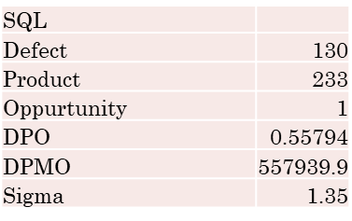
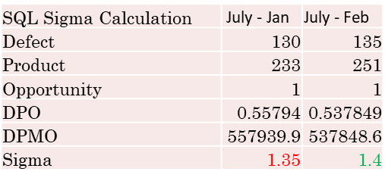
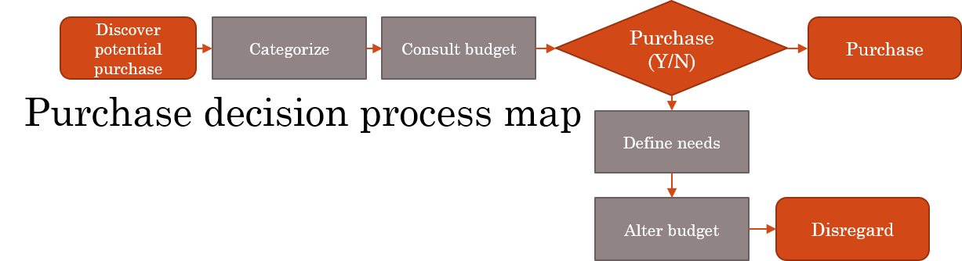
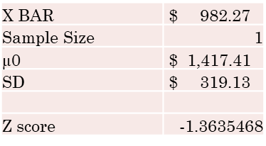
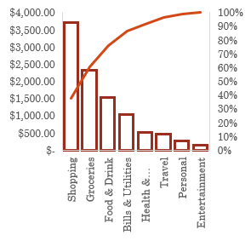
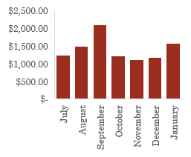
(D) DEFINE
(M) MEASURE
(A) ANALYZE
(I) IMPROVE
(C) CONTROL
W1-2 Problem: Monthly spending varies greatly. Spending is too high, spending standard deviation is too high. There is inconsistent income left over for saving each month. Impact: Reduce spending, identify unnecessary expenses, categorize expenses, formulate an ideal budget strategy. Lower monthly spending StDev and average. Avg Monthly Spending : $1417.41 Range : $987.82 StDev : $319.13) | W2-3 | W3-6 SQL Essential/Non Shopping is the largest expense and categorized as non-essential, therefore the best target to reduce spending | W6-7 Hypothesis: Reducing the amount of non-essential purchases will lower my mean monthly expenditure. Ho : Mean monthly expenditure increases or stays the same. (µ ≥ $1417.41) Ha : Mean monthly expenditure decreases. (µ < $1417.41) | W8 Monthly expenditure in February decreases significantly compared to previous months (down $435.14) Febuary brought the mean of monthly purchases down and coincidently raised the SD and range. This indicated this month is an outlier for the previous months. Success! (with a caveat) Although spending has decreased and I’ve reduced non-essential purchases, I need more monthly data to strengthen the proof.
Shows the monthly spikes (September/ January)
Data Collection:
My data source was all exported from my credit card history.
Major contributor to high expenses is shopping. Best target for reduction.
Only applicable targets are non-essential purchases.
SQL Calculation using non-essential purchases as defects, results in very low efficiency of purchases
SQL V2 (Above)
Sigma level of essential purchases increased, with more months like February it should increase even more
‘Shopping’ is the highest % of total
Not enough data for accurate test
No easily visible correlation between amount of non-essential purchases and total monthly expenditure.
This control run chart shows that my purchases are in control. I think this is due to a lack of data and because the data came before any attempt at control. REJECT!

Slide 3
(D)
DEFINE
F(x)=y
X : Types of purchases, total price of purchase ($), balances ($), amount of income gained($).
Y : Savings ($)
Impact:
Reduce spending, identify unnecessary expenses, categorize expenses, formulate an ideal budget strategy. Lower monthly saving StDev and monthly spending and raise Monthly Saving Average

Slide 4
(D) Define
Process Map
A chance check if the potential purchase is essential or not.
Purchase (Y/N)
Y
Discover potential purchase
Categorize
Consult budget
Purchase
N
Process Steps:
Steps ‘Categorize’, ‘Define needs’, and ‘Evaluate Budget’ are steps of my process that are self improving. They will inform my budget and allow me to gradually improve the effectiveness and standardization of my decision-making process.
Define needs
Evaluate budget
Disregard
A chance to change the categorization of non-essential

Slide 5
(M) MEASURE
Data collected Via Chase Credit card, allows for pulling of data from before this projects start. Date range of initial data: 7/1/19 -> 1/30/20, Sample Size = 233
Data collected includes: Transaction Date, Month, Description, Category, Amount, and Essential Rating. The last data point essential rating is a manual data-point, essential (1) or nonessential(0) based on its category, cost, description, or any combo of the 3.

Slide 6
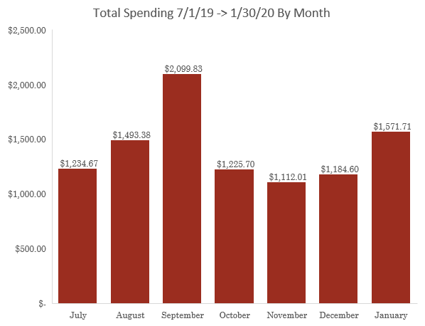
(M) MEASURE
Measuring from a glance.
Histogram:
This histogram shows which months had the highest expenses. My assumption is that those months (Sept, Jan) had more ‘Shopping’ expenses than the others, and maybe more expensive grocery bills.
Data Types:
When grouping my data like this I will treat it as continuous. i.e. monthly expenses as continuous data.
The actual data from each individual purchase is discrete. Whereas it has the potential to not exist.

Slide 7
(M) MEASURE
Data Stratification Tree
Process Questions | Stratification Factors (X Var) | Measurements
What dates are the highest money spent? Does spending vary by Day? | Transaction Date | Total purchase amount on Date
What Months have the most liberal spending? Does spending vary by Month? | Month | Total purchases in Month % of purchases in Month
Does spending vary by Week? | Day of Week | Total purchases on specific DOW % of purchases in DOW
What are the most expensive purchases? Do some repeat? | Description | Most frequent purchases Repetition of purchases
What category of purchases has the highest spending? What category is the most expensive essential and least essential? | Category | Total spending within category % Category is of Total spending Ratio of total category spending to % essential
What is the typical purchase amount? | Amount | Average purchase amount per day Standard deviation
What essential or nonessential purchases would be most effective to reduce or eliminate? | Essential Rating | Frequency of purchase, amount of purchase, repetitiveness of purchase.
New Purchases
(Y)

Slide 8
(M) MEASURE
Non-essentiality rating will be my p (percent defective), calculating the ideal sample size of with a 99% confidence level and a margin of error of .1 my data results in ideal of 163.66 (my sample exceeds that.)
The resulting calculation may be skewed. Although I created a chart to decide if a purchase was a success or a failure, the rules were chosen arbitrarily.
Category | Essential | Non-Essential
Bills & Utilities | Insurance, Power | Streaming
Entertainment | Never | Always
Food & Drink | If <= $10 | If > $10
Groceries | If <= $100 | If > $100
Health & Wellness | Always | Never
Personal | If < $100 | If > $100
Shopping | Never | Always
Travel | Gas | Uber, Vacation Travel
Sample Size (n) | 233
Count of Non-essential (0) | 130
Count of Essential (1) | 103
Percent Defective (p) | 55.79%
Percent Effective (q) | 44.21%
Confidence level | 0.99
z | 2.576
Standard Dev | 0.496632
Upper Limit (U) | 64.18%
Lower Limit (L) | 47.41%
Margin of Error (E) | 0.1
Sample Size for Discrete | 163.6667
Rules for deciding essentiality
Result for sample size calculation

Slide 9
(M) MEASURE
More Histograms:
When counting the amount of essential purchases by week and month, it becomes clear that this count doesn’t necessarily corelate with actual monthly expenditure.
Looking back at the ‘Monthly Total Spending’ histogram you can see that peak months like September, do not have higher than average non-essential purchases.
I expect that this is because there is no measure of ‘how’ frivolous or non-essential a purchase was, it could have been just barely qualified as non-essential or far beyond my requirements.

Slide 10
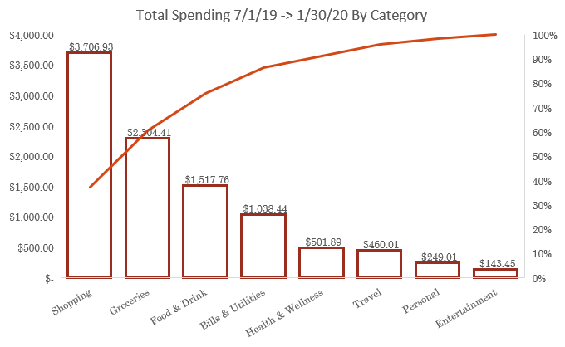
(A)
ANALYZE
Pareto:
Shows the categories which are the highest expenses. Combine this info with the count of non-essential purchases to the left and you can see that shopping while being the highest expense is also the lease essential. Consequently this also makes said categories the most effective candidates for reducing expenses.
Essential vs Non | Essential | Non essential
Groceries | 42 | 2
Food & Drink | 32 | 56
Shopping | 0 | 50
Travel | 12 | 8
Personal | 5 | 1
Bills & Utilities | 8 | 7
Entertainment | 0 | 6
Health & Wellness | 4 | 0

Slide 11
(A) ANALYZE
In this chart I noticed that my monthly expenditure appeared to be in control. My assumption is that this is because of a small set of data, I think with more data the controls will drift closer to the mean. Also there is more variation in the chart then what I would like.
The moving range further proves my assumption about variation. The variation in outlier months like September dramatically raise the average moving range: $385.45. Consequently this raises the URL, making it seem like the process is in control.
My conclusion here is that more data is needed.

Slide 12
(A) ANALYZE
Run Chart comparison
Comparing a run charts with purchases grouped by Month and Week, respectively.
I noticed that the weekly run chart shows some dramatic spikes, pointing again to large purchases as the major influence on monthly expenditure. Therefore I do not think looking for a pattern will help reduce spending.

Slide 13
(A) ANALYZE
Hypothesis
SQL: Using non-essential purchases as my defects and using
my ‘decision to purchase’ from the process map as the one
‘opportunity’ I was able to calculate the sigma quality level
for the purchasing thought process. I got a pretty low score;
1.35, that really gives me room for improvement.
The caveat here is that my process is discrete and the SQL of how essential vs non-essential my purchases are may have a range of effects on how much money I spend. Although I will still calculate the SQL score after I attempt to improve, I do not feel it is a perfect analogue spending less money, therefore I won’t include it in my hypothesis.
SQL
Defect | 130
Product | 233
Oppurtunity | 1
DPO | 0.55794
DPMO | 557939.9
Sigma | 1.35
Hypothesis:
Reducing the amount of non-essential purchases will lower my mean monthly expenditure.
Ho : Mean monthly expenditure increases or stays the same.
(µ ≥ $1417.41)
Ha : Mean monthly expenditure decreases.
(µ < $1417.41)

Slide 14
(I)
IMPROVE
In the previous phases I identified several contributing factors to high monthly expenditure.
High ‘Shopping’ expenses
Too many ‘non-essential’ purchases
Very low SQL score for essential purchases
My Action Plan:
Use process map to pilot a potential purchase
Reduce non-essential purchases (with a focus on shopping purchases)
A hypothesis test on my previous Hypothesis:
Ho : (µ ≥ $1417.41)
Ha : (µ < $1417.41)
In this test I treat the monthly expenditure as continuous data, and return a Z score of -1.36, so my sample mean for the one February sample is within 2 standard deviations of the original mean. In this case I would reject the null as the sample falls far below the original mean. However being that the sample size is so small and how monthly expenditure could still be considered discrete and not continuous this hypothesis test isn’t a good measure.
Regardless, the monthly expenditure for February decreased significantly compared to earlier months.
X BAR | $ 982.27
Sample Size | 1
µ0 | $ 1,417.41
SD | $ 319.13
Z score | -1.3635468

Slide 15
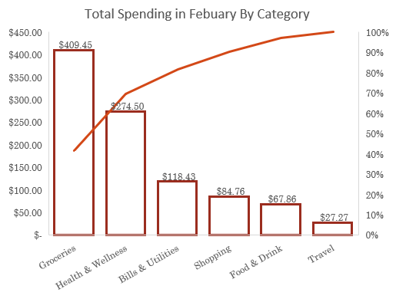
(C) CONTROL
Looking at the pareto chart to the right I noticed that February’s breakdown of purchases greatly differs from the months prior. Shopping is the 4th greatest expense instead of the 1st and the overall total for the month is lower than all other months from the previous sample.
I also decided to do a SQL calculation to see if my choices of essential vs non-essential purchases improved, and although I never expect a score in the higher range like a 4 or a 5 I did see some improvement. When comparing the new Sigma Quality level with the old I can see some small improvement, so it is safe to say in February I was better and avoiding non-essential purchases.
SQL Sigma Calculation | July - Jan | July - Feb
Defect | 130 | 135
Product | 233 | 251
Opportunity | 1 | 1
DPO | 0.55794 | 0.537849
DPMO | 557939.9 | 537848.6
Sigma | 1.35 | 1.4

